Slide 1
What red wine should I buy from the LCBO?
Shameer Sukha
December 2020

Slide 2
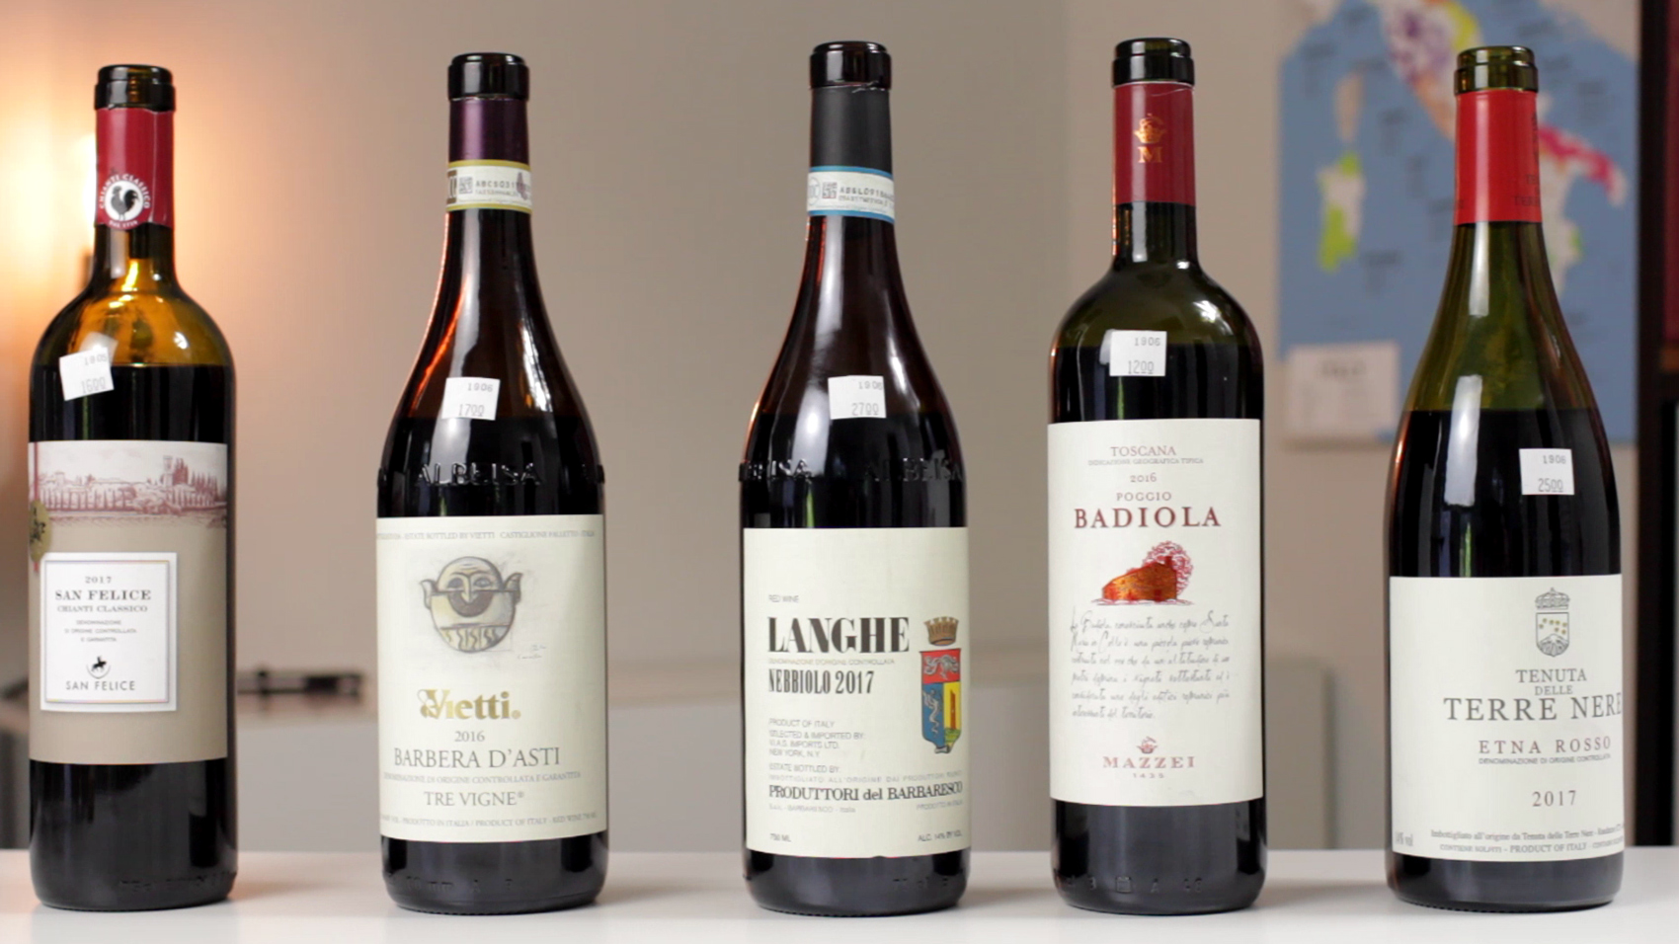
Red wine has an X-factor
Has been produced since immemorial times
Natural, colour
Complex flavour
Social, stature, shared with others
Art, beautiful
Notes:
Wine was produced since before anyone can remember, apparently the Gods have tasted it!
What is it about it? That it is natural (unlike Coke)? Is it the attractive colour? Or the complex flavour?
Perhaps it is that we love to share it with others? Makes us feel social, gives us some sort of stature?
Is it the Art around producing it, and the beautiful bottles or labels?
The answer varies for different people and difficult to nail down.
I think it certainly has an x-factor compared to other beverages.

Slide 3
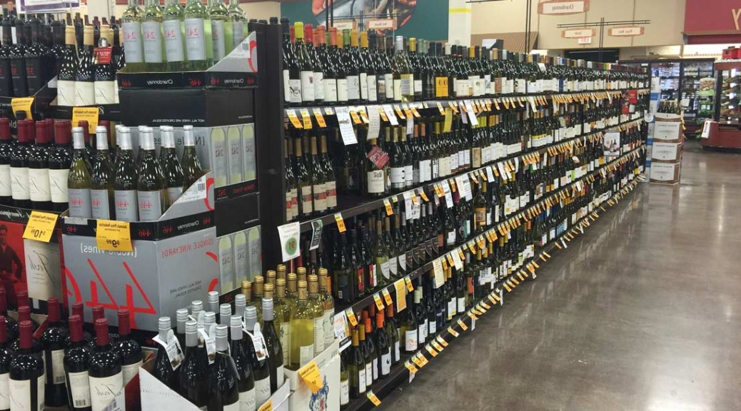
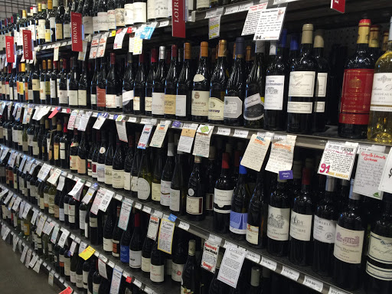
What is your shopping experience like?
Notes:
My experience buying red wine is:
Typically know what wine I’m going to buy based on what I’ve already had
But I’m always curious and constantly willing to try something new
In search of the most amazing wine ever…
…the one that was served to the Gods!
So I end up buying something on a whim, based on price, score on shelf if exists and absolutely fall for the marketing gimmicks

Slide 4
Which bottle would you buy?
Trapiche
The Prisoner
Perhaps not so good because of bottle cap?
Must be good because it has a cork?
Must be good because it has lots of awards stickers?
Perhaps not so good because negative connotation?
Notes:
Consumer’s hate buyer’s remorse.
Especially with wine, etiquette is to return a bottle only if it is corked…
…not if you don’t enjoy it!
But the X-factor of red wine keeps consumers coming back for more…
…keep trying until you find that wine that was served to the Gods!

Slide 5
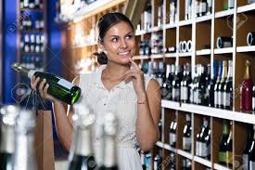
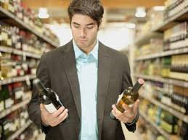
Data can help minimise buyer remorse!
Confident consumer spends more?
We will buy wine if we tasted it,
or if a family-member recommended it,
or if a friend recommended it,
or if a wine connoisseur recommended it,
or if lots of other random people recommended it.

Slide 6
What red wine should I buy from the LCBO?
Combining price data from LCBO.com with average rating scores data from vivino.com will help provide insights to answer this question.

Slide 7
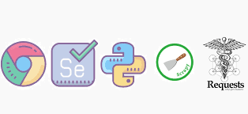
Webscraping LCBO.com and vivino.com
Vivino
Online marketplace and wine app
Easy to identify wine by taking picture of bottle
Provides comprehensive information about wine
~10mn wines and ~35mn users
Lots of reviews and rating scores
Liquor Control Board of Ontario
Government organisation
regulates all alcoholic beverages in Ontario
Actionable and reliable prices

Slide 8
How I collected the data
LCBO used BeautifulSoup since relatively straightforward and easy
Vivino knows that people are after their data!
Ripe target for Scrapy if using their API or search functionality
Otherwise need to use Selenium because scrolling reveals more info
Used BeatifulSoup+search feature
Did not scrape more than I needed for purposes of answering my question

Slide 9
Webscraping challenges and insights
Vivino shows >450,000 items of red wine but scrolling through pages via API has a cap at some point. Can only get ~2200 bottles
Use LCBO name in vivino search box yielded good results on average but had some random cap at some point in the process, needed to iterate several times
Vivino blocked my IP address about 5 times
Lost all my data after several hours of collection (testing code that wrote test data to the same file)

Slide 10
Data-wrangling challenges and insights
Started off using Python
Helped identify 2ml incorrect, was part of 2 x 750mL
Regex helped extract vintage from name and clean text
Highly skewed distribution of price
Creating price per mL was important metric to identify value
Joining of LCBO and vivino dataframes not required (simple merge sufficed) due to search function approach of inputing LCBO name into vivino and scraping result
However validation of name matches was now required

Slide 11
Stitch data with Fuzzy Wuzzy!
 | LCBO | Vivino
Bottle name scraped | {Alario Claudio Nebbiolo D'Alba Cascinotto DOC} | {Claudio Alario Cascinotto Nebbiolo d'Alba}
Excel Vlookup (True and False) | #N/A
Levenshtein distance (simple ratio) | 60
Levenshtein distance (partial ratio) | 63
Levenshtein distance (token sort) | 95
Levenshtein distance (token set) | 100
• Good explanation of fuzzy wuzzy package and relation to Levenshtein distance can be found here: https://www.datacamp.com/community/tutorials/fuzzy-string-python

Slide 12
What red wine should I buy from the LCBO?
LCBO vs vivino rating score will help solve this question
However matplotlib is not easy with interactivity to pick up insights
Given current skillset, decision to use R shiny for data visualisation and analysis

Slide 13
Interesting insights
LCBO stocks wine from 33 countries including: West Bank (Palestine), Moldova, Macedonia and China.
Most reds are from Italy, then France, then USA. (Canada is 6th)
However, the most popular region is California followed by Tuscany
Total red items > 6000 including bagnboxs, cans and tetrapacks
Cheapest item is can $2.35 (750ml bottle is $5.80) and most expensive is $9,990

Slide 14
Interesting insights
Marqués de Riscal Rioja Reserva is the bottle with most ratings >150,000 (costs $28, Spain)
Remoissenet Père & Fils Clos Saint-Denis has the highest rating of 4.8 (costs $665, France)
Most expensive wines $5k-$10k are from France. Italy takes over at $2k-$4k
By far France has best ‘brand’ in that it commands highest price per mL ($2-8 per mL)

Slide 15
Interesting insights
Lowest-rated wine has score of 2 (Sangre de Toro Red $10.85, Spain)
Most expensive wine rated < 3.5 (Chateau Canon, France, $2,250 3L)
Most expensive unit price < 3.5 (Marchesi di Barolo, Italy, $1089, 750mL)
Highly-rated most popular wines (>100,000 ratings)
Caymus Cabernet Sauvignon (4.6, USA, $110-$220)
Tignanello Sangiovese Blend (4.5 , Italy, $140-$240)
Meiomi Pinot Noir (4.1, USA, $20)

Slide 16
Interesting insights
Consumers likely rating US wines better than critics
Consumers seem to be in-line with critics on Italian wines
Critics likely rating French wines better than consumers
Italy better rated than French, which is better than US
US and Spain have ratings distributions that are uncannily similar (so do Portugal and Argentina)

Slide 17
What red wine should I buy from the LCBO?
Shameer Sukha

Slide 18
Wine | Rating | Price | Rationale
Biondi Santi Brunello di Montalcino (2009 and 2011) | 4.5 | $280 | Unit price of $0.37 offers great value and matches both of my sons’ birth years. Critic scores of 93 and 94 and >20,000 ratings
Tignanello (2006) | 4.5 | $286 | Unit price of $0.38 offers great value, over 100,000 ratings, critic score of 96. Matches my wedding anniversary year
French Roots Merlot Cabernet Sauvignon & Jelly | None | $6 | Try cheapest bottle of wine just for kicks, maybe I can be the first to review it on vivino!
Marqués de Riscal Rioja Reserva | 4.0 | $28 | Most number of ratings of all bottles. Rating might be a really good reflection of what a 4.0 means!
Caymus Cabernet Sauvignon | 4.6 | $109 | We love Cab Sav’s from California, this is the one to keep for those special occasions. It is very popular
Hagafen Estate Cabernet Sauvignon | 4.6 | $69 | Cheaper, high quality Cab Sav to try and see how it compares to Caymus (since Caymus has higher brand value)
Austin Hope Cabernet Sauvignon | 4.5 | $70 | I really mean it when I say we love Cab Sav’s from California, why not add this to the mix and judge for ourselves
Nino Negri 5 Stelle Sfursat 2015 Nebbiolo | 4.5 | $53 | Cheapest wine rated 4.5, with a unit price of $0.07 and critic score of 94. Feel like I’m missing out
Papale Linea Oro Primitivo di Manduria | 4.4 | $24 | We don’t like Primitivo’s in general but this is worth a try. Bonus, it has a critic score of 90.
Remo Farina Amarone della Valpolicella Classico | 4.4 | $44 | Looks like a steal at $0.06 for an Amarone for this rating. Critic score of 92!
Meiomi | 4.1 | $20 | At first, the price of $20 sounds wrong given it’s track record, how much we enjoyed it in the past and what we paid for it ($28)

Slide 19
Thank you and further work…
Scrape more data like varietal, reviews, classifications, alcohol content.
Conduct more in-depth analysis on underlying drivers of ratings and price
Dare I say, try to predict price, given other predictor variables including rating score?
Use NLP to text mine reviews for wine descriptors like, plum, blackcurrant, leather, oak etc.
Create a signature for a particular wine using descriptors and dare I say develop the ‘Netflix’ of wine? A user specifies what wine they have consumed and based on the descriptor signature, matches are found with same or higher rating and same or lower price.

